Slide 1
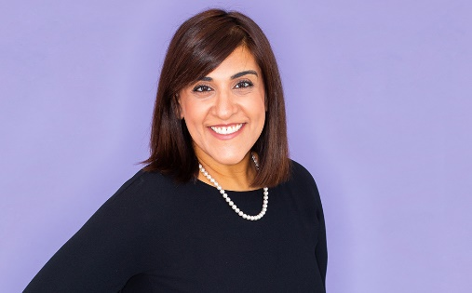

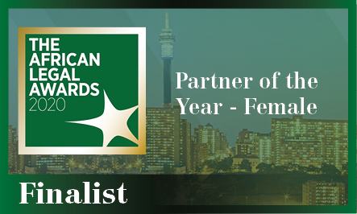

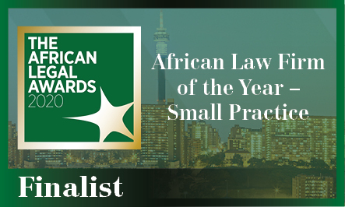

Zara Jamal is a Partner at Abreu Advogados since 2016, and at JLA Advogados, Abreu Advogados’ associate firm in Mozambique, since 2014.
She works primarily on the implementation of international businesses and project finance transactions in Mozambique, focusing particularly on the banking, insurance, real estate, agriculture and energy sectors.
Her practice centers particularly in the areas of banking, finance, corporate and regulatory law, often advising on international project financing transactions.
Her experience includes Islamic Banking having provided services for Murabaha’s first transaction in Mozambique.
Experience
Advising a South African private equity firm on the structuring, development and implementation of a real estate complex comprising a shopping center and hotel in Maputo.
Advising the financiers on a project finance of an LNG project in Mozambique.
Advising the financiers on a project finance related to a heavy sand mining project in Mozambique.
Advising a Mozambican bank on the issuance of bonds and on respective listing admission to the Mozambican stock exchange.
Advising a Turkish airline carrier on their operations in Mozambique.
Advising a Turkish group on the implementation and operation of a cement plant in Mozambique.
Advising a British investment fund on the acquisition of a participating interest in an agro company in Mozambique.
Advising two European institutions on investments in Mozambique.
Advising a Chinese bank on financing a banking entity operating in Mozambique.
Advising a South African investment fund on the project finance of a Mozambican company operating in the forestry industry.
Zara
Jamal
Practice Areas
Finance
Partner, Mozambique
Industries
Banking & Financial
Mining
Oil & Gas
Desk
Education
Mozambique Desk
Faculdade de Direito da Universidade Católica Portuguesa
Law degree (2006)
Faculdade de Direito da Universidade de Lisboa
Postgraduate degree in Information Society Law (2008)
Instituto do Direito Económico, Financeiro e Fiscal
Postgraduate degree in Competition Law and Regulation (2009)
Faculdade de Direito de Universidade de Lisboa
Postgraduate degree in Intellectual Property (2010)
World Intellectual Property Organization
Postgraduate degree in Intellectual Property, in Dubrovnik, Croatia (2011)
London School of Business and Finance
Postgraduate degree in Islamic Banking & Finance (2012)
St,Catherine’s College, Oxford University
Postgraduate degree in International Finance Law (2017)
Languages
English, Spanish
Recognitions

